Slide 1
Knowledge Byte
  In this section, you will learn about:
    Trusted and untrusted applets
    Advanced Drawing methods in Java
    Setting Color, Font, Style, and Size of Text in an Applet
    Gridbag Layout Manager
    Anonymous classes

Slide 2
Trusted and Untrusted Applets
An applet is an interactive Java program that runs inside an appletviewer or a
Java-compatible Web browser.
The sandbox model of Java ensures the security of Java code when an applet runs.
Being confined to the sandbox model, an applet cannot perform functions, such as reading, writing, or deleting files from the local file system.
This type of applet is known as an untrusted applet.
An untrusted applet is prevented from accessing files on the local computer and accessing network connection from the computer.
A trusted applet enables you to perform operations, such as reading and writing data to a local computer.
A trusted applet is digitally signed by a trusted source.
PolicyTool is the trusted source provided by the JDK 1.2.

Slide 3
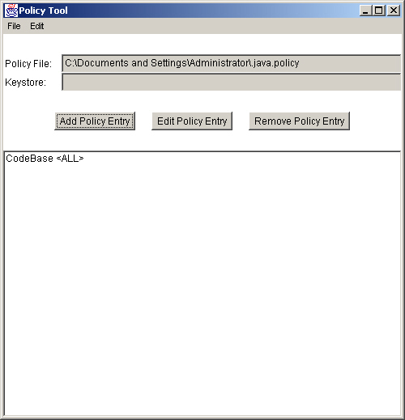
Trusted and Untrusted Applets (Contd.)
  Steps to create a policy
    Open the command prompt window.
    Type PolicyTool and press the Enter key to open the Policy Tool dialog box

Slide 4
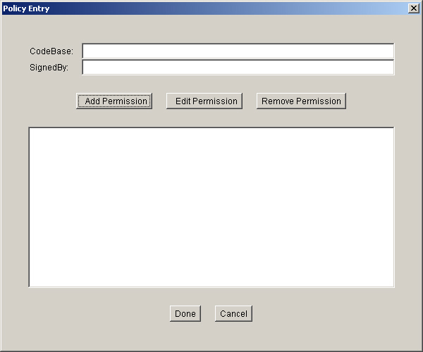
Trusted and Untrusted Applets (Contd.)
    Click the Add Policy Entry button in the Policy Tool dialog box to add an entry for new policy.

Slide 5
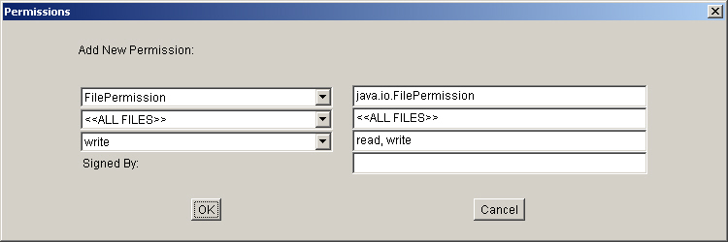
Trusted and Untrusted Applets (Contd.)
    Click the Add Permission button in the Policy Entry dialog box to specify the permissions for a desired file. The Permissions dialog box is displayed.
    Select the required permissions from the FilePermission drop-down list.
    Select the file on which you want to apply permissions from the Target Name drop-down list.

Slide 6
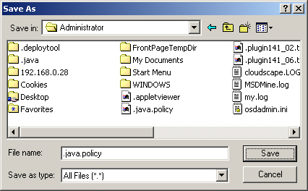
Trusted and Untrusted Applets (Contd.)
    Select the permissions, such as read, write, and execute from the Actions drop-down list.
    Click the OK button in the Permissions dialog box to apply the desired settings for adding a new permission.
    Click the Done button in the Policy Entry dialog box to complete the process of adding the new policy entry.
    Save the file by the name java.policy in the C:\Documents and Settings\ Administrator by selecting the Save or Save As option from the File menu.

Slide 7
Trusted and Untrusted applets (Contd.)
  When an applet is loaded on the Web, it is first checked if an applet by the same name exists in the classpath.
  If an applet of the same name exists, the applet found in the classpath is loaded.
  An applet loaded in this manner is a trusted applet.
  If no applet is found with the same name in the class path, then the applet is loaded from the location specified by the page that contains the applet.
  An applet loaded in this manner is an untrusted applet.

Slide 8
Drawing Methods in Java
  The drawRoundRect(), draw3DRect(), and fillRoundRect() methods are the advanced drawing methods used for creating drawings in an applet.
  The drawRoundRect() method is used to draw a rectangle with rounded corners.
  The fillRoundRect() method is used to draw a filled round cornered rectangle.
  A 3D rectangle and a filled 3D rectangle can be drawn using the draw3DRect() and fill3DRect() methods.

Slide 9
Setting Color, Font, Style, and Size of Text in an Applet
  Java provides the Color class that contains various color methods to apply the foreground and background colors to an applet.
  Syntax to set a desired color for an applet is Color.color_name.
    The Color class accepts the color_name argument to set the desired color, such as Color.red for drawing or writing text in an applet.
  The syntax to create your own colors for an applet is Color(int red, int green, int blue)
    The arguments of the Color class specify the proportion of three different colors, red, green, and blue. The integer values lie in the range of 0 to 255.
  The setColor() method applies drawing color to an applet.

Slide 10
Setting Color, Font, Style, and Size of Text in an Applet (Contd.)
  Java provides the Font class that enables you to write text in an applet using different fonts.
  The syntax shows how to create an instance of the Font class is Font f = new Font(font family, font style, font size);
    The Font class provides a variety of font family, such as Arial, Courier, Helvetica, and Futura. You can also apply different font sizes and styles, such as BOLD, ITALIC, and PLAIN.

Slide 11
GridBag Layout Manager
  The GridBag layout manager divides a container into a grid of equally sized cells. In the GridBag layout, a component can extend over multiple rows and columns.
  You specify the position of each component by specifying its x and y coordinates.
  You can resize the component by assigning weights to the components in the GridBag layout. Weights specify the horizontal and vertical space required to fill the display area of a container.
  The constructor to create an instance of the GridBagLayout class is GridBagLayout() g = new GridBagLayout();
  The syntax to define the setLayout() method is panel.setLayout(g);
  You need to specify the constraints for each component, when you want to size and position the components.
  You apply the constraints in the GridBag layout manager by using the setConstraints() method.

Slide 12
GridBag Layout Manager (Contd.)
  Constructors of the GridBagConstraints class
    GridBagConstraints(): Creates a GridBagConstraints object with the default values for the gridbag layout attributes.
    GridBagConstraints(int gridx, int gridy, int gridwidth, int gridheight, double weightx, double weighty, int anchor, int fill. Insets insets, int ipadx, int ipady): Creates a GridBagConstraints object with the specified values for the gridbag layout attributes.
Attribute
Description
gridx
Specifies the row in the top-left display area of the component. The extreme left column has the value of gridx as zero.
gridy
Specifies the column in the top-left display area of the component. The topmost cell has the value of gridy as zero.

Slide 13
GridBag Layout Manager (Contd.)
Attribute
Description
gridheight
Specifies the number of rows in the display area of a component. The default value for the gridheight argument is one.
gridwidth
Specifies the number of columns in the display area of a component. The default value for the gridwidth is one.
weightx
Specifies the horizontal space required to fill the display area of a container. The default value for the weightx argument is zero.
weighty
Specifies the vertical space required to fill the display area of the container. The default value for the weighty argument is zero.

Slide 14
GridBag Layout Manager (Contd.)
Attribute
Description
anchor
Determines the position of a component, when the size of the component is smaller than its display area.
insets
Specifies the minimum space between the components and the edges of the display area. The default value of insets is 0,0,0 that represents the top, left, bottom, and right coordinates.
ipadx
Specifies the minimum space added to the horizontal side of a component. The default value for the ipadx argument is zero.
ipady
Specifies the minimum space added to the vertical side of a component. The default value for the ipady argument is zero.

Slide 15
GridBag Layout Manager (Contd.)
  Values for the anchor attribute
Value
Description
GridBagConstraints.CENTER
Places the component at the center of a container.
GridBagConstraints.NORTH
Places the component to the north of a container.
GridBagConstraints.NORTHEAST
Places the component to the north-east of a container.
GridBagConstraints.EAST
Places the component to the east of a container.

Slide 16
GridBag Layout Manager (Contd.)
Value
Description
GridBagConstraints.SOUTHEAST
Places the component to the south-east of a container.
GridBagConstraints.SOUTH
Places the component to the south of a container.
GridBagConstraints.WEST
Places the component to the west of a container.
GridBagConstraints.NORTHWEST
Places the component to the north-west of a container.

Slide 17
GridBag Layout Manager (Contd.)
  Values for the fill attribute
Value
Description
GridBagConstraints.NONE
Applies the default values for the GridBag constraints.
GridBagConstraints.HORIZONTAL
Fills the display area horizontally but do not change the height of the component.
GridBagConstraints.VERTICAL
Fills the display area vertically but do not change the width of the component.
GridBagConstraints.BOTH
Fills the whole display area.

Slide 18
GridBag Layout Manager (Contd.)
  Methods of the GridBagLayout class
Method
Description
AddLayoutComponent(Component c, Object o)
Adds the specified component to the layout by using the constraints specified by the passed parameter.
addLayoutComponent(String str, Component c)
Adds the specified component with the specified name to the layout.
getConstraints(Component c)
Retrieves the constraints for the specified component.
getLayoutAlignmentX(Container con)
Retrieves the alignment along the
x-axis of a container.

Slide 19
GridBag Layout Manager (Contd.
Method
Description
getLayoutAlignmentY(Container con)
Retrieves the alignment along the
y-axis of a container.
getLayoutDimensions()
Retrieves the dimensions of the layout grid.
getLayoutWeights()
Retrieves the weights of the rows and columns of the layout grid.
location(int x, int y)
Retrieves the cell in the layout grid containing the point specified by x and y coordinates.

Slide 20
GridBag Layout Manager (Contd.)
Method
Description
maximumLayoutSize(Container con)
Returns the maximum dimensions of the layout in the specified container.
minimumLayoutSize(Container con)
Returns the minimum size of the container by using the GridBag layout.
preferredLayoutSize(Container con)
Retrieves the preferred size of the container using the GridBag layout.
removeLayoutComponent(Component c)
Removes the specified component from the layout.
toString()
Returns a string representation of the GridBag layout values.

Slide 21
Anonymous Classes
  Anonymous classes combine the tasks of declaring a class and creating its instance in a single step.
  An anonymous class must implement the tasks
    Extends a superclass
    Implements all the abstract methods of the superclass
    Uses the default constructor of the superclass to create its instance
  Anonymous classes are an enhancement of inner classes. An inner class is a nested class and its instance exists within an instance of its enclosing class.

Slide 22
From the Expert’s Desk
  In this section, you will learn:
    Best practices on:
      Running Applets
      Inner and Adapter Classes
    Tips and Tricks on:
      Applets
    FAQs

Slide 23
Best Practices
Running Applets
  You need to include all the graphics in an applet in separate threads. This makes the process of navigation easier as an end user does not have to wait for large pictures to be downloaded.
Inner and Adapter Classes
  You need to use inner classes for writing adapter classes so that you can directly operate on the methods and variables of a class.

Slide 24
Tips and Tricks
Applets
  You must override the stop() method of an applet to release all the resources, such as threads occupied by the applet. The stop() method enables you to use the resources released by an applet for another applet.

Slide 25
FAQs
  How is a Java applet different from a Java stand-alone application?
Applet
Application
Can be embedded in an HTML Web page
Cannot be embedded in an HTML Web page
Runs inside a Java-capable browser, such as Internet Explorer, Netscape Navigator, and HotJava
Runs on the command prompt by using the Java interpreter
Cannot read or write to the file system
Can read or write to the file system

Slide 26
FAQs (Contd.)
  How can you run an applet in a browser, which is not Java-compatible?
  You can run an applet with the appletviewer tool included with the JDK, when a browser is not Java-compatible.
  Why would you use parameters with an applet?
  You need to pass parameters to an applet whenever you want to send the details to a Java file through an HTML file. You pass parameters to an applet by using the <PARAM> tag. The <PARAM> tag contains the NAME and VALUE attributes. The NAME attribute specifies the name of the parameter passed to an applet, and the VALUE attribute specifies the value of the variable to be passed.

Slide 27
FAQs (Contd.)
  Which mouse event is most commonly captured and responded in a Java applet?
  MOUSE_CLICKED is the most commonly captured and responded event in a Java applet.
  How can you convert an applet to an application?
  You can convert an applet to an application by including the main() method in the applet. The declarations included in the init() method of the applet need to perform in the constructor of the class. The applet class needs to extend from a frame and size, and visibility of the frame is set in the main() method.
  If you want to handle all events in a single method, which method can you use to override in your applet?
  You can handle all the events in a single method by overriding the handleEvent() method.

Slide 28
Challenge
  1. What special HTML tag is used to place a Java program in a Web page?
  a. <APPLET>
  b. <PROGRAM>
  c. <RUN>
  d. <HEAD>
  2. Match the following:
  a. init() i. Called by the browser when the user moves to another page.
  b. stop() ii. Called the first time an applet is loaded into the memory of the
  computer.
  c. update() iii. Called the first time an applet is displayed on the screen.
  d. start() iv. Called every time an applet loses the focus.
  e. paint() v. Called every time an applet receives the focus.
  f. destroy() vi. Called to clear the screen.

Slide 29
Challenge(Contd.)
  3. The FlowLayout Manager is the default layout manager for swing applications. (True/False)
  4. The Adapter class used for the _____ interface is the WindowAdapter class.
  5.An anonymous class cannot have a constructor. (True/False)

Slide 30
Solutions to Challenge
  1. (a)
  2. a-ii, b-iv, c-vi, d-v, e-iii, f-i
  3. True
  4.WindowListener
  5. True

